Slide 1
MERN INTRODUCTION

Slide 2
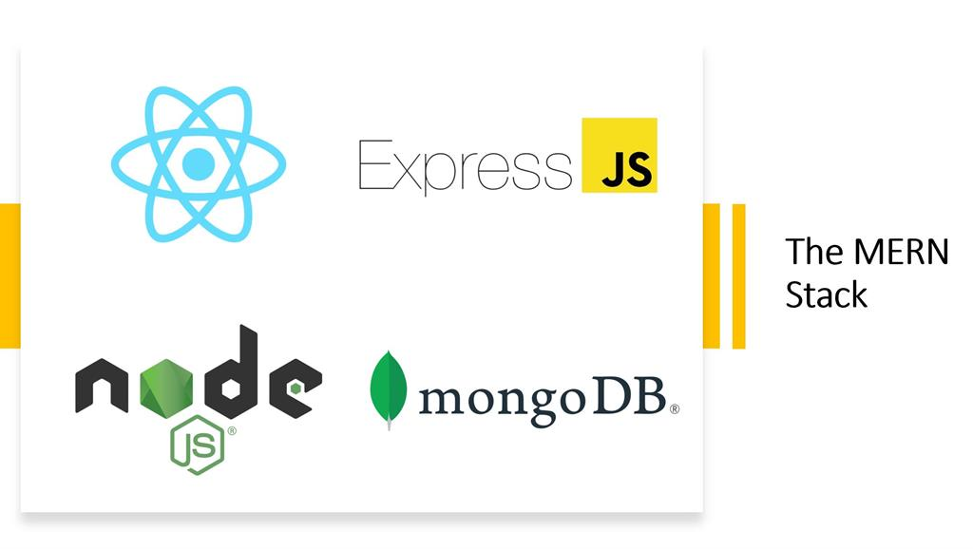

Slide 3
MERN Stack Introduction
MERN stands for MongoDB, Express, React, Node
MongoDB – document database
Express.js – Node.js web framework
React.js – a client-side JavaScript Library
Node.js – the premier JavaScript web server
React JS
Node JS
Express JS
MongoDB

Slide 4
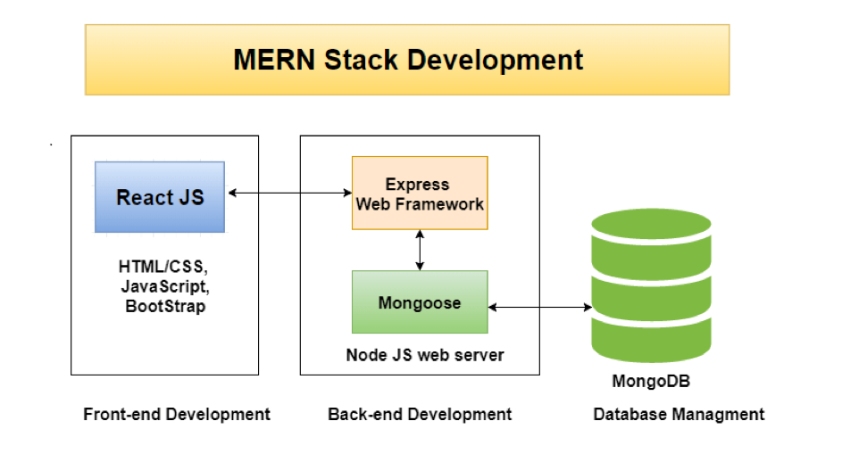
Notes:
Mongoose is a JavaScript framework that is commonly used in a Node.js application with a MongoDB database.

Slide 5

MERN Stack React.JS
Front End Library (The top tier of MERN Stack)
The declarative JavaScript Library for creating dynamic client-side applications
Build up complex interfaces through
simple Components,
connect them to data on your backend server, and
render them as HTML
Strengths include
handling stateful, data-driven interfaces
great support for forms, error handling, events, lists, etc.

Slide 6


MERN Stack
Node.JS and Express.JS
Server side Framework (The middle tier of MERN Stack)
Express.js server-side framework, running inside a Node.js server
Has powerful models for URL routing (matching an incoming URL with a server
function), and handling HTTP requests and responses
In turn use Node.js MongoDB drivers, either via callbacks for using Promises, to access and update data in your MongoDB database

Slide 7

MERN Stack MongoDB
Database Server (The bottom tier of MERN Stack)
Application data store(user profiles, content, comments, uploads, events, etc.)
JSON documents created in the front end can be stored directly in MongoDB for
later retrieval through Node.JS and Express.JS

Slide 8
REACTJS INTRODUCTION

Slide 9
Typical issue while building SPA
In a single page application, the bulk of your time will be spent keeping your data in-sync with your UI
Manipulating the DOM is really slow
Working with HTML templates can be a pain

Slide 10
ReactJS Introduction
ReactJS is a declarative, efficient, and flexible JavaScript library for building reusable UI components.
It is an open-source, component-based front end library responsible only for the view layer of the application.
It was created by Jordan Walke, who was a software engineer at Facebook.
It was initially developed and maintained by Facebook and was later used in its products like WhatsApp & Instagram.
Facebook developed ReactJS in 2011 in its newsfeed section, but it was released to the public in the month of May 2013.
Today, most of the websites are built using MVC (model view controller) architecture. In MVC architecture, React is the 'V' which stands for view.

Slide 11
ReactJS Introduction
A ReactJS application is made up of multiple components, each component responsible for outputting a small, reusable piece of HTML code.
The components are the heart of all React applications.
These Components can be nested with other components to allow complex applications to be built of simple building blocks.
ReactJS uses virtual DOM based mechanism to fill data in HTML DOM.
The virtual DOM works fast as it only changes individual DOM elements instead of reloading complete DOM every time.

Slide 12
React.JS Introduction
Facebook (and Instagram) released a library called React to not only address these shortcomings, but to also change how we think about building single-page apps
Advantages
Automatic UI State Management
Lightning-fast DOM Manipulation
APIs to Create Component based UIs
Visuals Defined Entirely in JavaScript

Slide 13
React.JS
Automatic UI State Management
With SPA, keeping track of your UI and maintaining state is hard
React keeps track of series of steps our users may have taken to change the UI
All of that state management stuff is no longer your concern

Slide 14
React.JS
Lightening Fast DOM Manipulation
React maintains a in-memory copy of the actual DOM known as the
virtual DOM
Manipulating this virtual DOM is extremely fast
React takes care of updating the real DOM when the time is right
Compares the changes between your virtual DOM and the real DOM
Figuring out which changes actually matter, and making the least amount of DOM changes

Slide 15
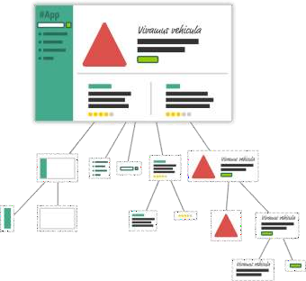
React.JS
Lightening Fast DOM Manipulation
React encourages you to break your visual elements into smaller and smaller components
have things be modular, compact, and self-contained

Slide 16
What is JSX?
JSX stands for JavaScript XML.
JSX allows us to write HTML in React.
JSX makes it easier to write and add HTML in React.
JSX allows us to write HTML elements in JavaScript and place them in the DOM without any createElement() and/or appendChild() methods.
JSX converts HTML tags into react elements.

Slide 17
React.JS
Visuals Defined Entirely in JavaScript
Define your visuals very easily using a syntax that is very familiar
Visuals and JavaScript often live in the same location
JSX JavaScript
ReactDOM.render(
<div>
<h1>Batman</h1>
<h1>Iron Man</h1>
<h1>Nicolas Cage</h1>
<h1>Mega Man</h1>
</div>,
destination );
ReactDOM.render( React.createElement ( "div", null,
React.createElement ( "h1", null, "Batman" ), React.createElement ( "h1", null, "Iron Man" ), React.createElement ( "h1", null, "Nicolas Cage" ), React.createElement ( "h1", null, "Mega Man" ),
destination);

Slide 18
React.JS Getting Started
Include the React JS Libraries
<script src="https://unpkg.com/react@16/umd/react.development.js"> </script>
<script src="https://unpkg.com/react-dom@16/umd/react-dom.development.js"> </script>
Include Babel (JSX to JavaScript Converter)
<script src="https://unpkg.com/babel-standalone@6.15.0/babel.min.js"></script>

Slide 19
React.JS
Displaying the first element
<div id="container"></div>
<script type="text/babel">
var destination = document.querySelector("#container");
ReactDOM.render(
<h1>React World</h1>, destination
);
</script>
<div id="container"></div>
<script type="text/babel">
var destination = document.querySelector("#container");
ReactDOM.render(
React.createElement( "h1", null, “React World" ), destination
);
</script>

Slide 20
Read and Understand
Self Learning on Mongoose
https://code.tutsplus.com/articles/an-introduction-to-mongoose-for-mongodb-and-nodejs--cms-29527

